Slide 1
MICROPROCESSOR 8085
Reference Book:
– Ramesh S. Goankar, “Microprocessor Architecture, Programming and Applications with 8085”, 5th Edition, Prentice Hall

Slide 2
Basic Concepts of Microprocessors
Differences between:
Microcomputer – a computer system with a microprocessor as its CPU. Includes memory, I/O etc.
Microprocessor – silicon chip which includes ALU, register circuits & control circuits
Microcontroller – silicon chip which includes microprocessor, memory & I/O in a single package.

Slide 3
What is a Microprocessor?
The word comes from the combination micro and processor.
- Micro: very very small
Processor : device that processes numbers,
specifically binary numbers, 0’s and 1’s.
*To process means to manipulate

Slide 4
Definition of the Microprocessor
The microprocessor is a programmable device that takes in numbers, performs on them arithmetic or logical operations according to the program stored in memory and then produces other numbers as a result.

Slide 5
Definition (Contd.)
Programmable device: The microprocessor can perform different sets of operations on the data it receives depending on the sequence of instructions supplied in the given program.
Instructions: Each microprocessor is designed to execute a specific group of operations. This group of operations is called an instruction set. This instruction set defines what the microprocessor can and cannot do.

Slide 6
Definition (Contd.)
Takes in: The data that the microprocessor manipulates must come from somewhere.
It comes from what is called “input devices”.
These are devices that bring data into the system from the outside world.
These represent devices such as a keyboard, a mouse, switches, and the like.

Slide 7
Definition (Contd.)
– Numbers: The microprocessor only understands binary numbers.
A binary digit is called a bit
The microprocessor recognizes and processes a group of bits together.
This group of bits is called a “word”.

Slide 8
Definition (Contd.)
Words, Bytes, etc.
The earliest microprocessor (the Intel 8088 and Motorola’s 6800) recognized 8-bit words.
They processed information 8-bits at a time. That’s why they are called “8-bit processors”.
Later microprocessors (8086 and 68000) were designed with 16-bit words.
A group of 8-bits were referred to as a “half-word” or “byte”.
A group of 4 bits is called a “nibble”.
Also, 32 bit groups were given the name “long word”.
Today, all processors manipulate at least 32 bits at a time and there exists microprocessors that can process 64, 80, 128 bits

Slide 9
Definition (Contd.)
Arithmetic And Logic Operations:
Add
Subtract
Multiply
Divide
Square Root
AND
OR
XOR
Shift Left
Shift Right

Slide 10
Definition (Contd.)
Stored in memory :
First, what is memory?
Memory is the location where information is kept while not in current use.
Memory is a collection of storage devices and are grouped into groups of 8.
Memory is usually measured by the number of bytes it can hold.
It is measured in Kilos, Megas and lately Gigas.
A Kilo in computer language is 2¹⁰ =1024.
So, a KB (KiloByte) is 1024 bytes.
Mega is 1024 Kilos and Giga is 1024 Mega.

Slide 11
Definition (Contd.)
Produces: For the user to see the result of the execution of the program, the results must be presented in a human readable form.
The results must be presented on an output device.
This can be the monitor, a paper from the printer, a simple LED or many other forms.

Slide 12
A Microprocessor-based system
Block diagram to represent a microprocessor-based system:
Input
Output
Memory

Slide 13
Inside The Microprocessor
Internally, the microprocessor is made up of 3 main units.
The Arithmetic/Logic Unit (ALU)
The Control Unit.
An array of registers for holding data while it is being manipulated.

Slide 14
Organization of a microprocessor- based system
I/O Input / Output
ALU | Register Array
Control
System Bus
Memory
ROM RAM

Slide 15
Memory
Memory stores information such as instructions and data in binary format (0 and 1). It provides this information to the microprocessor whenever it is needed.
Usually, there is a memory “sub-system” in a microprocessor-based system. This sub-system includes:
The registers inside the microprocessor
Read Only Memory (ROM)
used to store information that does not change.
Random Access Memory (RAM) (also known as Read/Write Memory).
used to store information supplied by the user. Such as programs and data.

Slide 16
Memory Map and Addresses
The memory map is a picture representation of the address range and shows where the different memory chips are located within the address range.
0000 0000
EPROM
RAM 1
RAM 2
RAM 3
RAM 4
Address Range of EPROM Chip
3FFF
4400
Address Range of 1st RAM Chip
5FFF
6000
Address Range of 2nd RAM Chip
Address Range
8FFF
9000
A3FF A400
Address Range of 3rd RAM Chip
Address Range of 4th RAM Chip
F7FF
FFFF

Slide 17
Memory
To execute a program:
the user enters its instructions in binary format into the memory.
The microprocessor then reads these instructions and whatever data is needed from memory, executes the instructions and places the results either in memory or produces it on an output device.

Slide 18
The three cycle instruction execution model
To execute a program, the microprocessor “reads” each instruction from memory, “interprets” it, then “executes” it.
To use the right names for the cycles:
The microprocessor fetches each instruction,
decodes it,
Then executes it.
This sequence is continued until all instructions are performed.

Slide 19
Machine Language
The number of bits that form the “word” of a microprocessor is fixed for that particular processor.
These bits define a maximum number of combinations.
For example an 8-bit microprocessor can have at most 2⁸ = 256 different combinations.
However, in most microprocessors, not all of these combinations are used.
Certain patterns are chosen and assigned specific meanings.
Each of these patterns forms an instruction for the microprocessor.
The complete set of patterns makes up the microprocessor’s machine language.

Slide 20
The 8085 Machine Language
The 8085 (from Intel) is an 8-bit microprocessor.
The 8085 uses a total of 246 bit patterns to form its instruction set.
These 246 patterns represent only 74 instructions.
The reason for the difference is that some (actually most) instructions have multiple different formats.
Because it is very difficult to enter the bit patterns correctly, they are usually entered in hexadecimal instead of binary.
For example, the combination 0011 1100 which translates into “increment the number in the register called the accumulator”, is usually entered as 3C.

Slide 21
Assembly Language
Entering the instructions using hexadecimal is quite easier than entering the binary combinations.
However, it still is difficult to understand what a program written in hexadecimal does.
So, each company defines a symbolic code for the instructions.
These codes are called “mnemonics”.
The mnemonic for each instruction is usually a group of letters that suggest the operation performed.

Slide 22
Assembly Language
Using the same example from before,
00111100 translates to 3C in hexadecimal (OPCODE)
Its mnemonic is: “INR A”.
INR stands for “increment register” and A is short for accumulator.
Another example is: 1000 0000,
Which translates to 80 in hexadecimal.
Its mnemonic is “ADD B”.
“Add register B to the accumulator and keep the result in the accumulator”.

Slide 23
Assembly Language
It is important to remember that a machine language and its associated assembly language are completely machine dependent.
In other words, they are not transferable from one microprocessor to a different one.
For example, Motorolla has an 8-bit microprocessor called the 6800.
The 8085 machine language is very different from that of the 6800. So is the assembly language.
A program written for the 8085 cannot be executed on the 6800 and vice versa.

Slide 24
“Assembling” The Program
How does assembly language get translated into machine language?
There are two ways:
1st there is “hand assembly”.
The programmer translates each assembly language instruction into its equivalent hexadecimal code (machine language). Then the hexadecimal code is entered into memory.
The other possibility is a program called an “assembler”, which does the translation automatically.

Slide 25
8085 Microprocessor Architecture
8-bit general purpose µp
Capable of addressing 64 k of memory
Has 40 pins
Requires +5 v power supply
Can operate with 3 MHz clock
8085 upward compatible

Slide 26
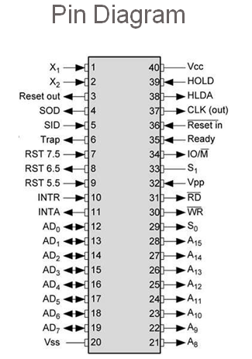

Slide 27
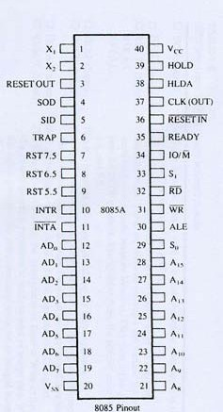
Pins
Power Supply: +5 V
Frequency Generator is connected to those pins
Input/Output/ Memory
Read
Write
Address latch Enable
Multiplexed Address Data Bus
Address Bus

Slide 28
0000
0001
FFFF

Slide 30
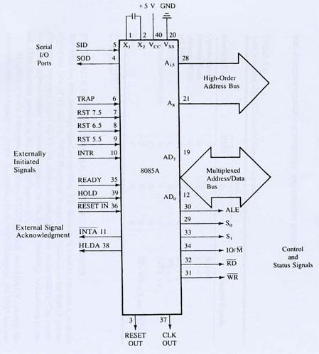

Slide 31
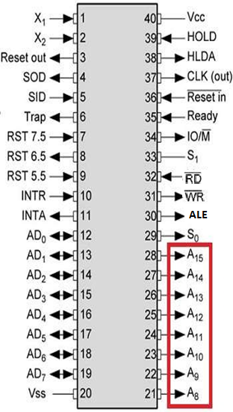
Address Bus
These pins carry the higher order of address bus.
The address is sent from microprocessor to memory.
A8 – A15. It carries the most significant 8-bit of memory I/O address.
30FFH
A15 A14 A13 A12 A11 A10 A9 A8
001100 0 0

Slide 32
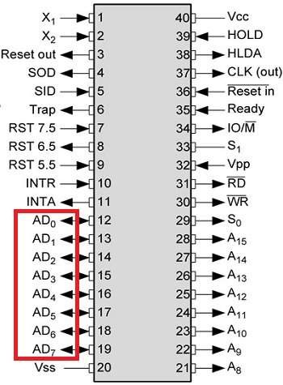
Data Bus
Data bus is of 8 Bit.
It is used to transfer data between microprocessor and memory.
AD0 – AD7. It carries the least significant 8-bit address and data bus.
30FFH
1111 1111

Slide 33
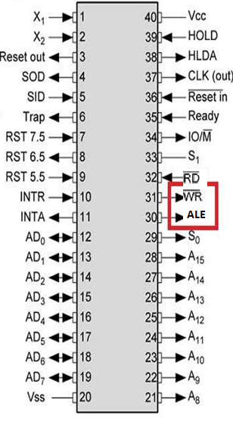
Control Signals
RD
This signal indicates that the selected IO or memory
device is to be read and is ready for accepting
data
available on the data bus.
WR
This signal indicates that the data on the data bus is to be written into a selected memory or IO location.

Slide 34

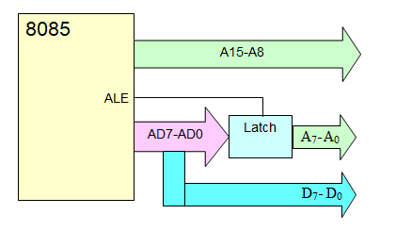
ALE Signal : Demultiplexing of buses

Slide 35
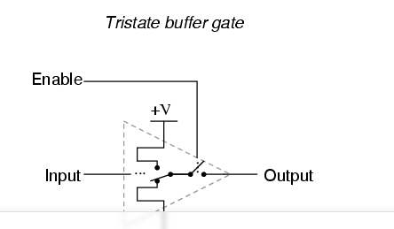

Slide 36
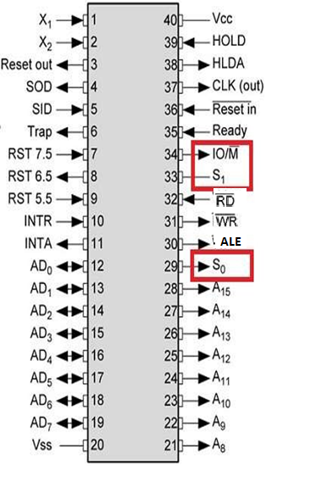
Status Signals
IO/M
This signal is used to differentiate between IO and Memory operations, i.e. when it is high indicates IO operation and when it is low then it indicates memory operation.
S0 & S1
These signals are used to identify the type of current operation.

Slide 37
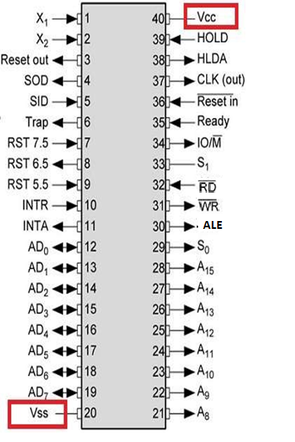
Power Supply
There are 2 power Supply signals:
VCC
VCC indicates +5v power supply.
VSS
VSS indicates ground signal.

Slide 38
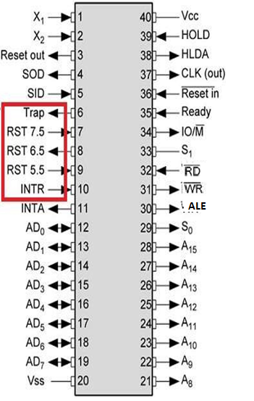
Interrupt Signals
TRAP
TRAP is usually used for power failure
and emergency shutoff.
RST 7.5
It is a maskable interrupt. It has the second highest priority.
RST 6.5
It is a maskable interrupt. It has the third highest priority.
RST 5.5
It is a maskable interrupt. It has the
fourth highest priority.
INTR
It is a general purpose interrupt. It is a maskable interrupt. It has the lowest priority.

Slide 39
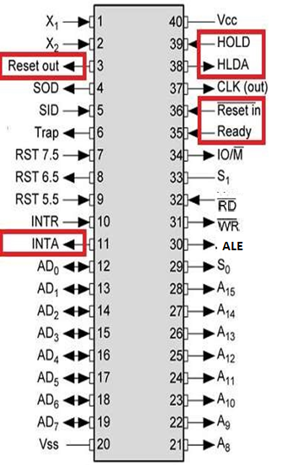
Externally Initiated Signals
INTA
It is an interrupt acknowledgment
signal.
RESET IN
This signal is used to reset the microprocessor by setting the program counter to zero.
RESET OUT
This signal is used to reset all the connected devices when the microprocessor is reset.

Slide 40
Externally Initiated Signals
Ready
This signal indicates that the device is ready to send or receive data. If READY is low, then the CPU has to wait for READY to go high.
HOLD
This signal indicates that another master is requesting the use of the address and data buses.
HLDA
It indicates that the CPU has received the HOLD request and it will relinquish the bus in the next clock

Slide 41
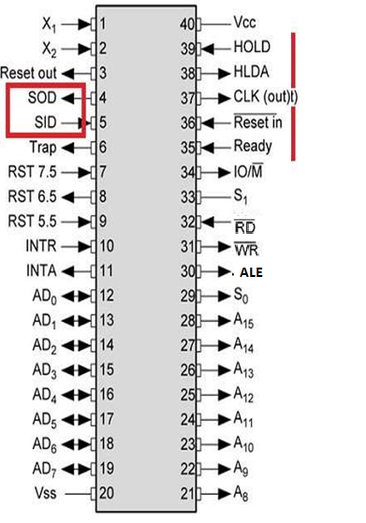
Serial I/O Signals
SOD
(Serial Output Data line) The output SOD is set/reset as specified by the SIM instruction.
SID
(Serial Input Data line)
The data on this line is loaded into accumulator whenever a RIM instruction is executed.

Slide 42
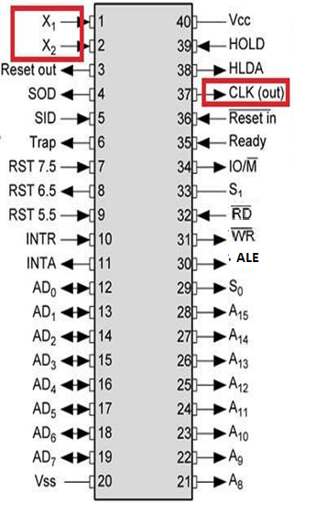
Clock signals
X1, X2
A crystal (RC, LC N/W) is connected at these two pins and is used to set frequency of the internal clock generator. This frequency is internally divided by 2.
CLK OUT
This signal is used as the system clock for devices connected with the microprocessor.

Slide 43
System Bus – wires connecting memory & I/O to microprocessor
Address Bus
Unidirectional
Identifying peripheral or memory location
Data Bus
Bidirectional
Transferring data
Control Bus
Synchronization signals
Timing signals
Control signal

Slide 44
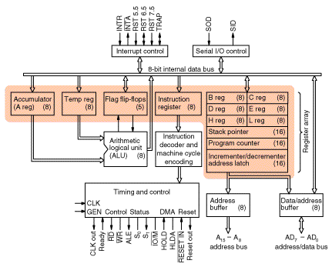
Architecture of Intel 8085 Microprocessor

Slide 45
Intel 8085 Microprocessor
Microprocessor consists of:
Control unit: control microprocessor operations.
ALU: performs data processing function.
Registers: provide storage internal to CPU.
Interrupts
Internal data bus

Slide 46
The ALU
In addition to the arithmetic & logic circuits, the ALU includes the accumulator, which is part of every arithmetic & logic operation.
Also, the ALU includes a temporary register used for holding data temporarily during the execution of the operation. This temporary register is not accessible by the programmer.

Slide 47
Registers
General Purpose Registers
B, C, D, E, H & L (8 bit registers)
Can be used singly
Or can be used as 16 bit register pairs
BC, DE, HL
H & L can be used as a data pointer (holds memory address)
Special Purpose Registers
Accumulator (8 bit register)
Store 8 bit data
Store the result of an operation
Accumulator | Flags
B | C
D | E
H | L
Program Counter
Stack Pointer
– Store 8 bit data during I/O transfer ^{Address}
16
8 Data

Slide 48
Flag Register
8 bit register – shows the status of the microprocessor before/after an operation
S (sign flag), Z (zero flag), AC (auxillary carry flag), P (parity flag) & CY (carry flag)
D7 | D6 | D5 | D4 | D3 | D2 | D1 | D0
S | Z | X | AC | X | P | X | CY
Sign Flag
Used for indicating the sign of the data in the accumulator
The sign flag is set if negative (1 – negative)
The sign flag is reset if positive (0 –positive)

Slide 49
Zero Flag
Is set if result obtained after an operation is 0
Is set following an increment or decrement operation of that register
10110011
+ 01001101
--------------- 1 00000000
Carry Flag
– Is set if there is a carry or borrow from arithmetic operation
1011 0101 |  | 1011 0101
+ 0110 1100 | - | 1100 1100
--------------- |  | ---------------
Carry 1 0010 0001 | Borrow 1 | 1110 1001

Slide 50
Auxillary Carry Flag
Is set if there is a carry out of bit 3
Parity Flag
Is set if parity is even
Is cleared if parity is odd

Slide 51
1100
1000
0010 0100

Slide 52
The Internal Architecture
We have already discussed the general purpose registers, the Accumulator, and the flags.
The Program Counter (PC)
This is a register that is used to control the sequencing of the execution of instructions.
This register always holds the address of the next instruction.
Since it holds an address, it must be 16 bits wide.

Slide 53
The Internal Architecture
The Stack pointer
The stack pointer is also a 16-bit register that is used to point into memory.
The memory this register points to is a special area called the stack.
The stack is an area of memory used to hold data that will be retreived soon.
The stack is usually accessed in a Last In First Out (LIFO) fashion.

Slide 54
Non Programmable Registers
Instruction Register & Decoder
Instruction is stored in IR after fetched by processor
Decoder decodes instruction in IR
Internal Clock generator
3.125 MHz internally
6.25 MHz externally

Slide 55
Demultiplexing AD7-AD0
8085
A15-A8
ALE
AD7-AD0
Latch
A₇- A₀
D₇- D₀
– Given that ALE operates as a pulse during T1, we will be able to latch the address. Then when ALE goes low, the address is saved and the AD7– AD0 lines can be used for their purpose as the bi-directional data lines.

Slide 56
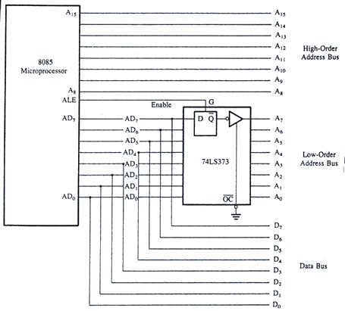

Slide 57
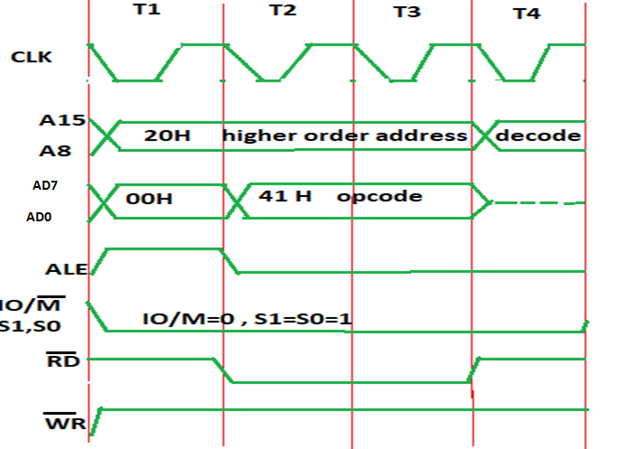
OPCODE READ MACHINE CYCLE 2000H=41H

Slide 58
The Address and Data Busses
The address bus has 8 signal lines A8 – A15 which are unidirectional.
The other 8 address bits are multiplexed (time shared) with the 8 data bits.
So, the bits AD0 – AD7 are bi-directional and serve as A0 – A7 and D0 – D7 at the same time.
During the execution of the instruction, these lines carry the address bits during the early part, then during the late parts of the execution, they carry the 8 data bits.
In order to separate the address from the data, we can use a latch to save the value before the function of the bits changes.

Slide 59
Demultiplexing AD7-AD0
The AD7– AD0 lines are serving a dual purpose and that they need to be demultiplexed to get all the information.
The high order bits of the address remain on the bus for three clock periods. However, the low order bits remain for only one clock period and they would be lost if they are not saved externally.
Use an external latch to save the value of AD7– AD0 when it is carrying the address bits. We use the ALE signal to enable this latch.

Slide 60
Demultiplexing the Bus AD7 – AD0
The high order address is placed on the address bus and hold for 3 clk periods,
The low order address is lost after the first clk period, this address needs to be hold with latch
The address AD7 – AD0 is connected as inputs to the latch 74LS373.
The ALE signal is connected to the enable (G) pin of the latch and the OC – Output control – of the latch is grounded

Slide 61
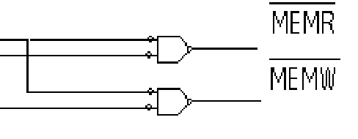
The Overall Picture
Putting all of the concepts together, we get:
^{A}15^{- A}10
Chip Selection Circuit
8085
A15-A8
CS
1K Byte Memory Chip
RD WR
ALE
A₉- A₀
AD7-AD0
Latch
A₇- A₀
WR RD IO/M
D₇- D₀

Slide 62
Introduction to 8085 Instructions

